Slide 1
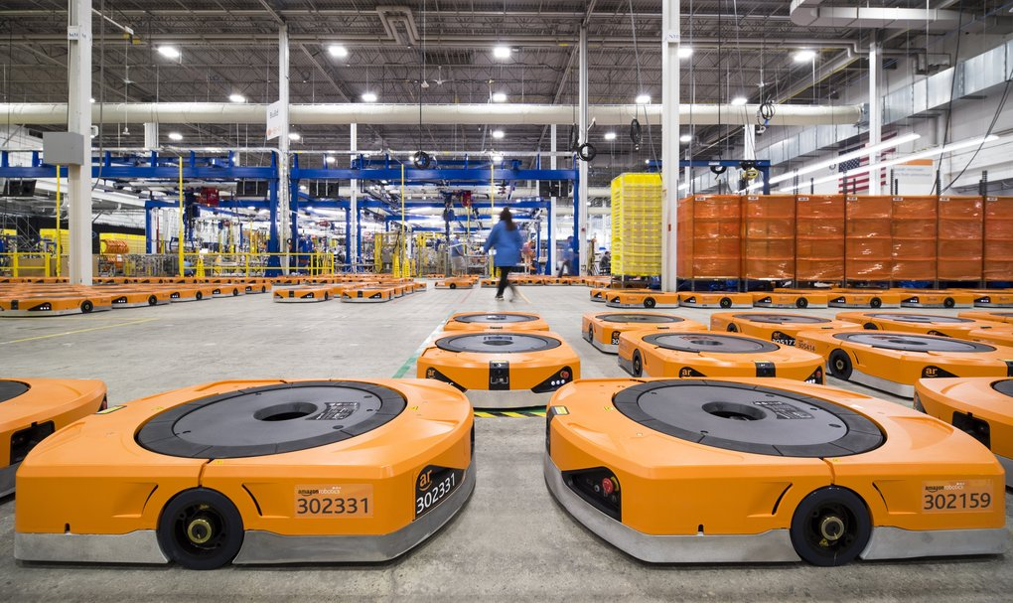
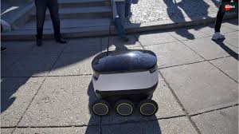
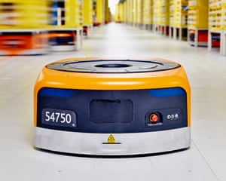
Robot-Walker
A simple example of a neural network development
Paolo Poli and Alessandro Zanetti

Slide 2
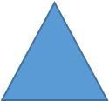
The goal
Any robot has to walk between the two assigned bases avoiding crashes with other robots

Slide 3

Programs and languages
Python to develop the neural network

Slide 4

Unity 3D to show the dynamic of the simulation
Programs and languages
Python to develop the neural network

Slide 5
Neural Network

Slide 6
Neural Network
[0,1]
[0=none,1=agent]

Slide 7
Neural Network
[0,1]
[0=none,1=agent]
[0,1]
[0=no base seen, 1=base seen]

Slide 8
Neural Network
[0,1]
[0=none,1=agent]
[0,1]
[0=no base seen, 1=base seen]

Slide 9
Neural Network
[0,1]
[0=none,1=agent]
[0,1]
[0=no rotation,1=rotation 90°]
[0=no move,1=move]
[0=no base seen, 1=base seen]

Slide 10
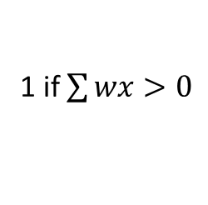
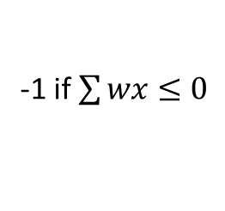
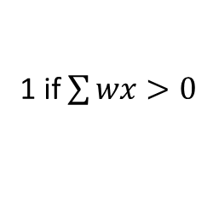
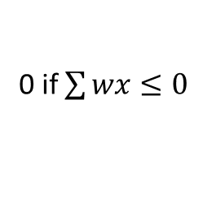
Activation functions
Total number of parameters=14+4=18
-1 if $\sum{wx≤0}$
0 if $\sum{wx≤0}$
1 if $\sum{wx>0}$
1 if $\sum{wx>0}$

Slide 11
Neural network training
Greedy method (it’s not compulsory to use specific methods in ML literature)

Slide 12
Neural network training
Greedy method (it’s not compulsory to use specific methods in ML literature)
Two random matrix were used, at the begin of the simulation with value between -1 and 1

Slide 13
Neural network training
Greedy method (it’s not compulsory to use specific methods in ML literature)
Two random matrix were used, at the begin of the simulation with value between -1 and 1
The training works increasing any value of the matrix of a random value between –ѡ and ѡ

Slide 14
Neural network training
Greedy method (it’s not compulsory to use specific methods in ML literature)
Two random matrix were used, at the begin of the simulation with value between -1 and 1
The training works increasing any value of the matrix of a random value between –ѡ and ѡ
The best performed matrix was chosen, any time the result was
better of previously results

Slide 15
Cost function
The cost function chosen, is the sum of the number times each robot reaches one of the two assigned bases

Slide 16
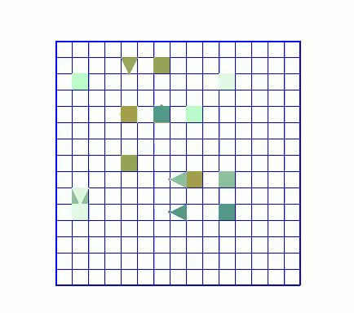
Results
The cost function chosen, is the sum of the number times of each robot reaches one of the two assigned bases
Untrained

Slide 17
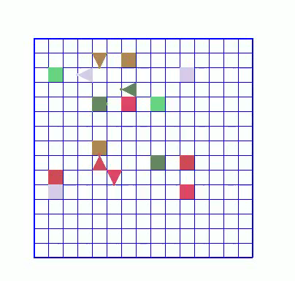
Results
The cost function chosen, is the sum of the number times of each robot reaches one of the two assigned bases
Untrained
trained

Slide 18
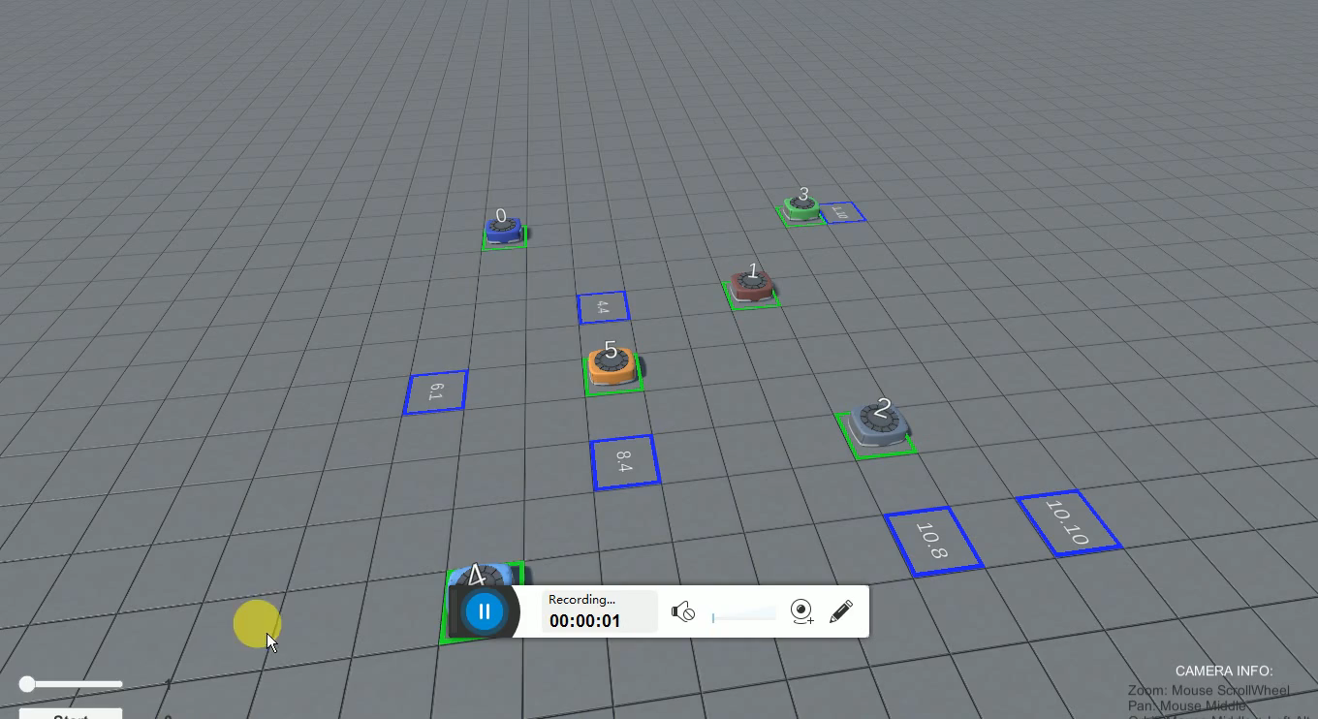
Results in Unity 3D

Slide 19
Conclusions
An interesting example of problem where a simple neural network
was coded has been shown
The goal was reached only by a simple laptop and with a normal
home pc
New things can be added at the problem putting new goals at the problem

Slide 20
Thanks!
Thanks everyone!

